Slide 2
What do we want to teach you in this course?
We don’t expect that you are UQ experts already
We will give you an introduction to the family of techniques within Uncertainty Quantification and what they can be useful for
There will be some useful examples from wind energy and coding tutorials
At the end of the course, we hope you will have an overview of what are the possibilities with UQ, and have knowledge of tools and other resources you can use to make your own UQ studies.

Slide 3
Learning objectives
Understand the wind turbine design assessment process and be familiar with the major standards and the prescriptions (load cases, limit states) defined in them
Know the building elements and the modelling chain required to set up a reliability assessment for offshore wind turbines (e.g. limit states, system variables, environmental variables and uncertainties)
Identify key variables and describe them through probability distributions
Select appropriate sampling strategies depending on the problem at hand (space-filling vs. for numerical integration)
Assess model uncertainty through comparing models of different fidelity
Carry out uncertainty propagation and numerical integration to compute reliability indexes
Train several types of surrogate models and carry out global sensitivity analysis
Know how to implement reliability and UQ problems in Python using existing frameworks

Slide 4
Requirements and evaluation
Credits: 2.5 ECTS
Structure of the course:
3 days of lectures + hands-on exercises
1 day of in-person project work
Submission of a 10-page report with project solutions, due 3 weeks later (Sept 22nd)
Grading:
Pass/Fail

Slide 5
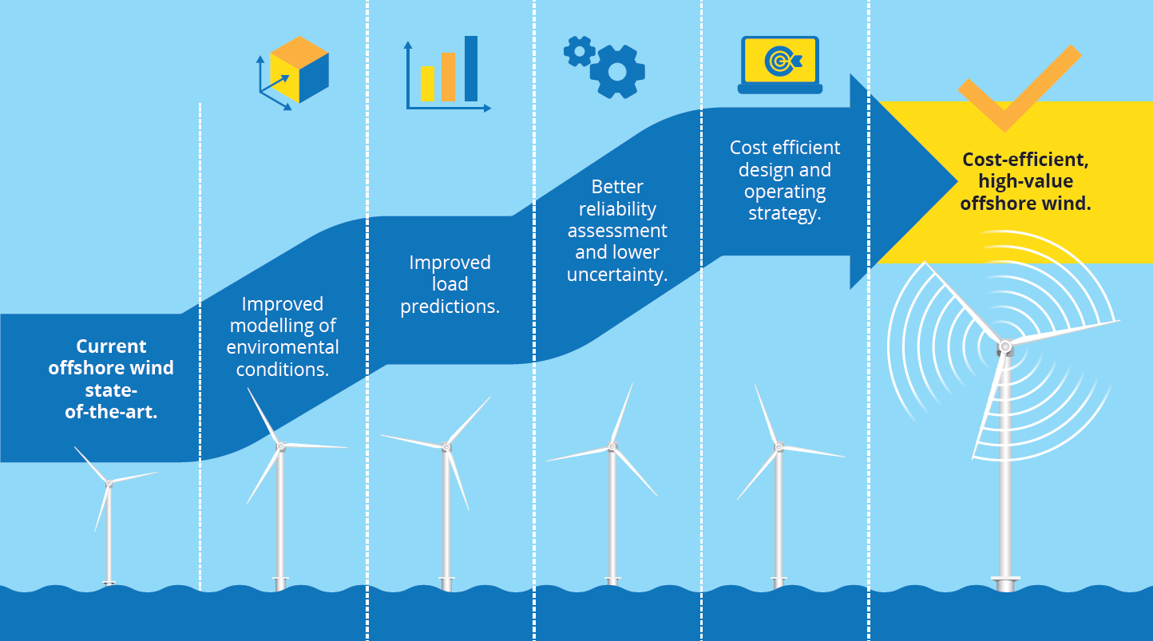
Background: the Hiperwind project

Slide 6
The teachers

Slide 7
Resources: useful links and data sets
Dataset 1: Time series of environmental conditions
Dataset 2: Database with fatigue load simulation results for a broad range of environmental conditions. IEA 15MW wind turbine placed on a monopile foundation

Slide 8
Introduction to probabilistic design

Slide 9
Why uncertainty?
The natural environment behaves randomly
Our measurements are limited (sample size) and imperfect (inexact)
How turbines respond to the environment is not perfect nor fully known
Our models are not perfect
The materials we use are not perfect
Our manufacturing processes are not perfect
We want to learn to “expect the unexpected”

Slide 10
Can we think of some uncertain phenomena in wind energy?
Plenary discussion

Slide 11
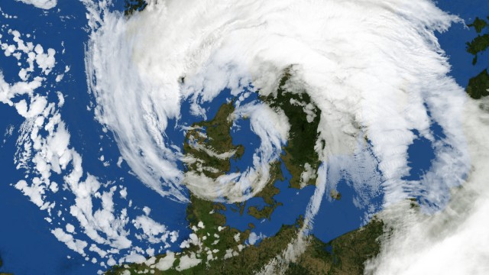
The extreme design wind speed
What is the maximum sustained wind speed that the turbine will experience during its lifetime?
IEC Class 1A: 50m/s
The “December hurricane” from 1999: 38m/s

Slide 12
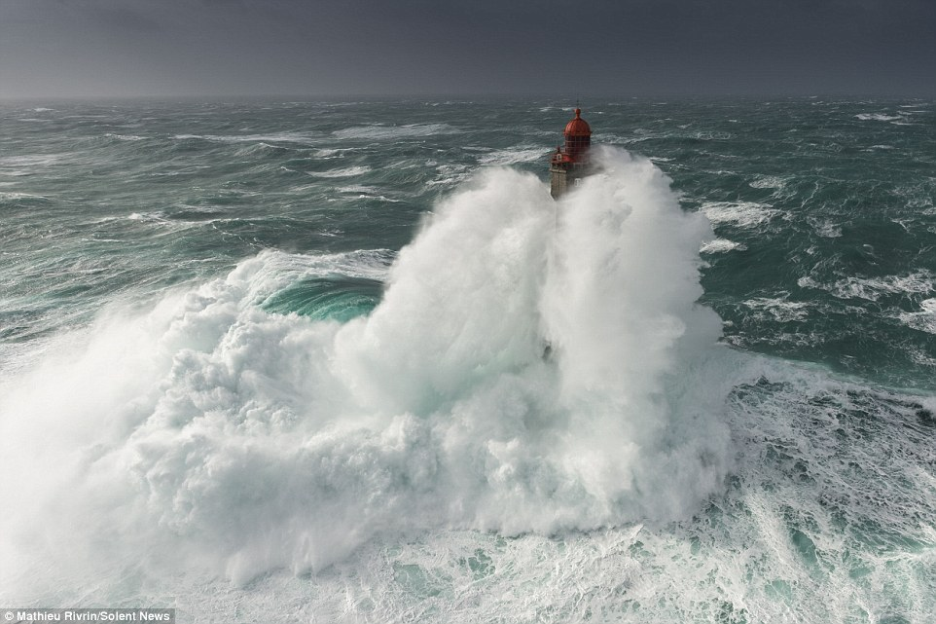
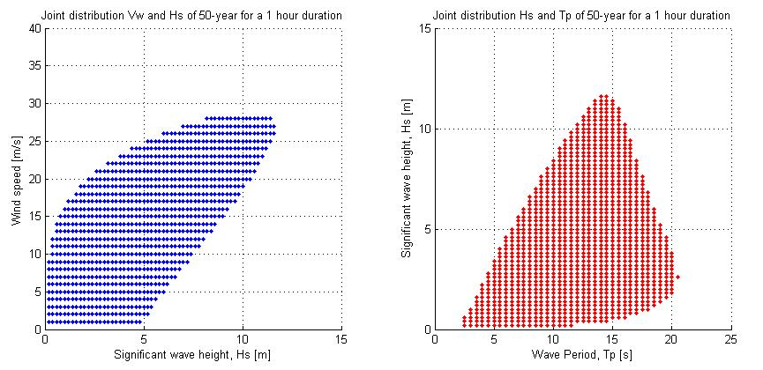
The elements, combined
The relation between wind and waves and its effect on turbine design

Slide 13
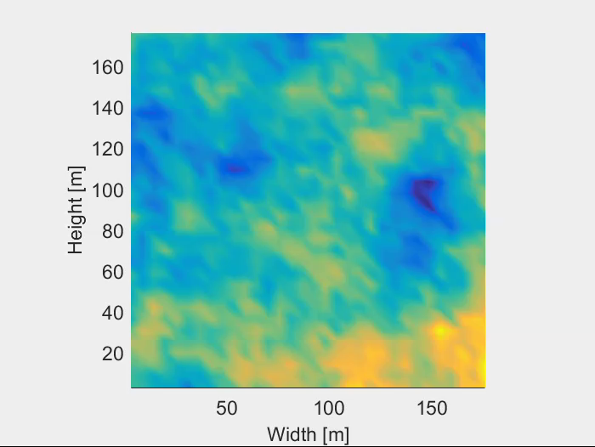
Turbulence
Turbulence is random by definition – and we need to take it into account when calculating loads and power output.
How do we generate turbulence fields for our models?
“When I meet God, I am going to ask him two questions: Why relativity? And why turbulence? I really believe he will have an answer for the first."
Werner Heisenberg

Slide 14
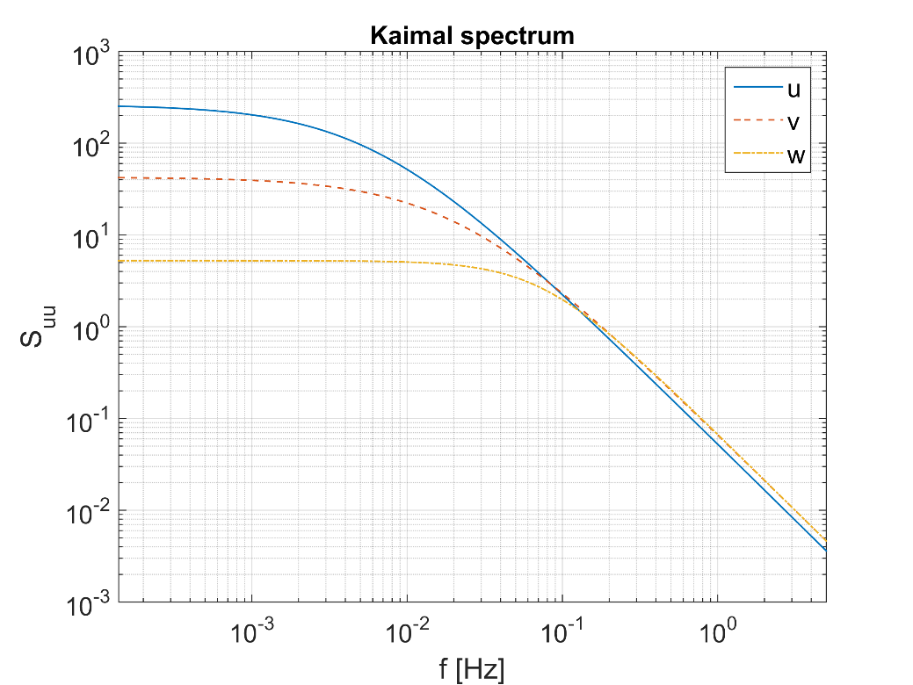
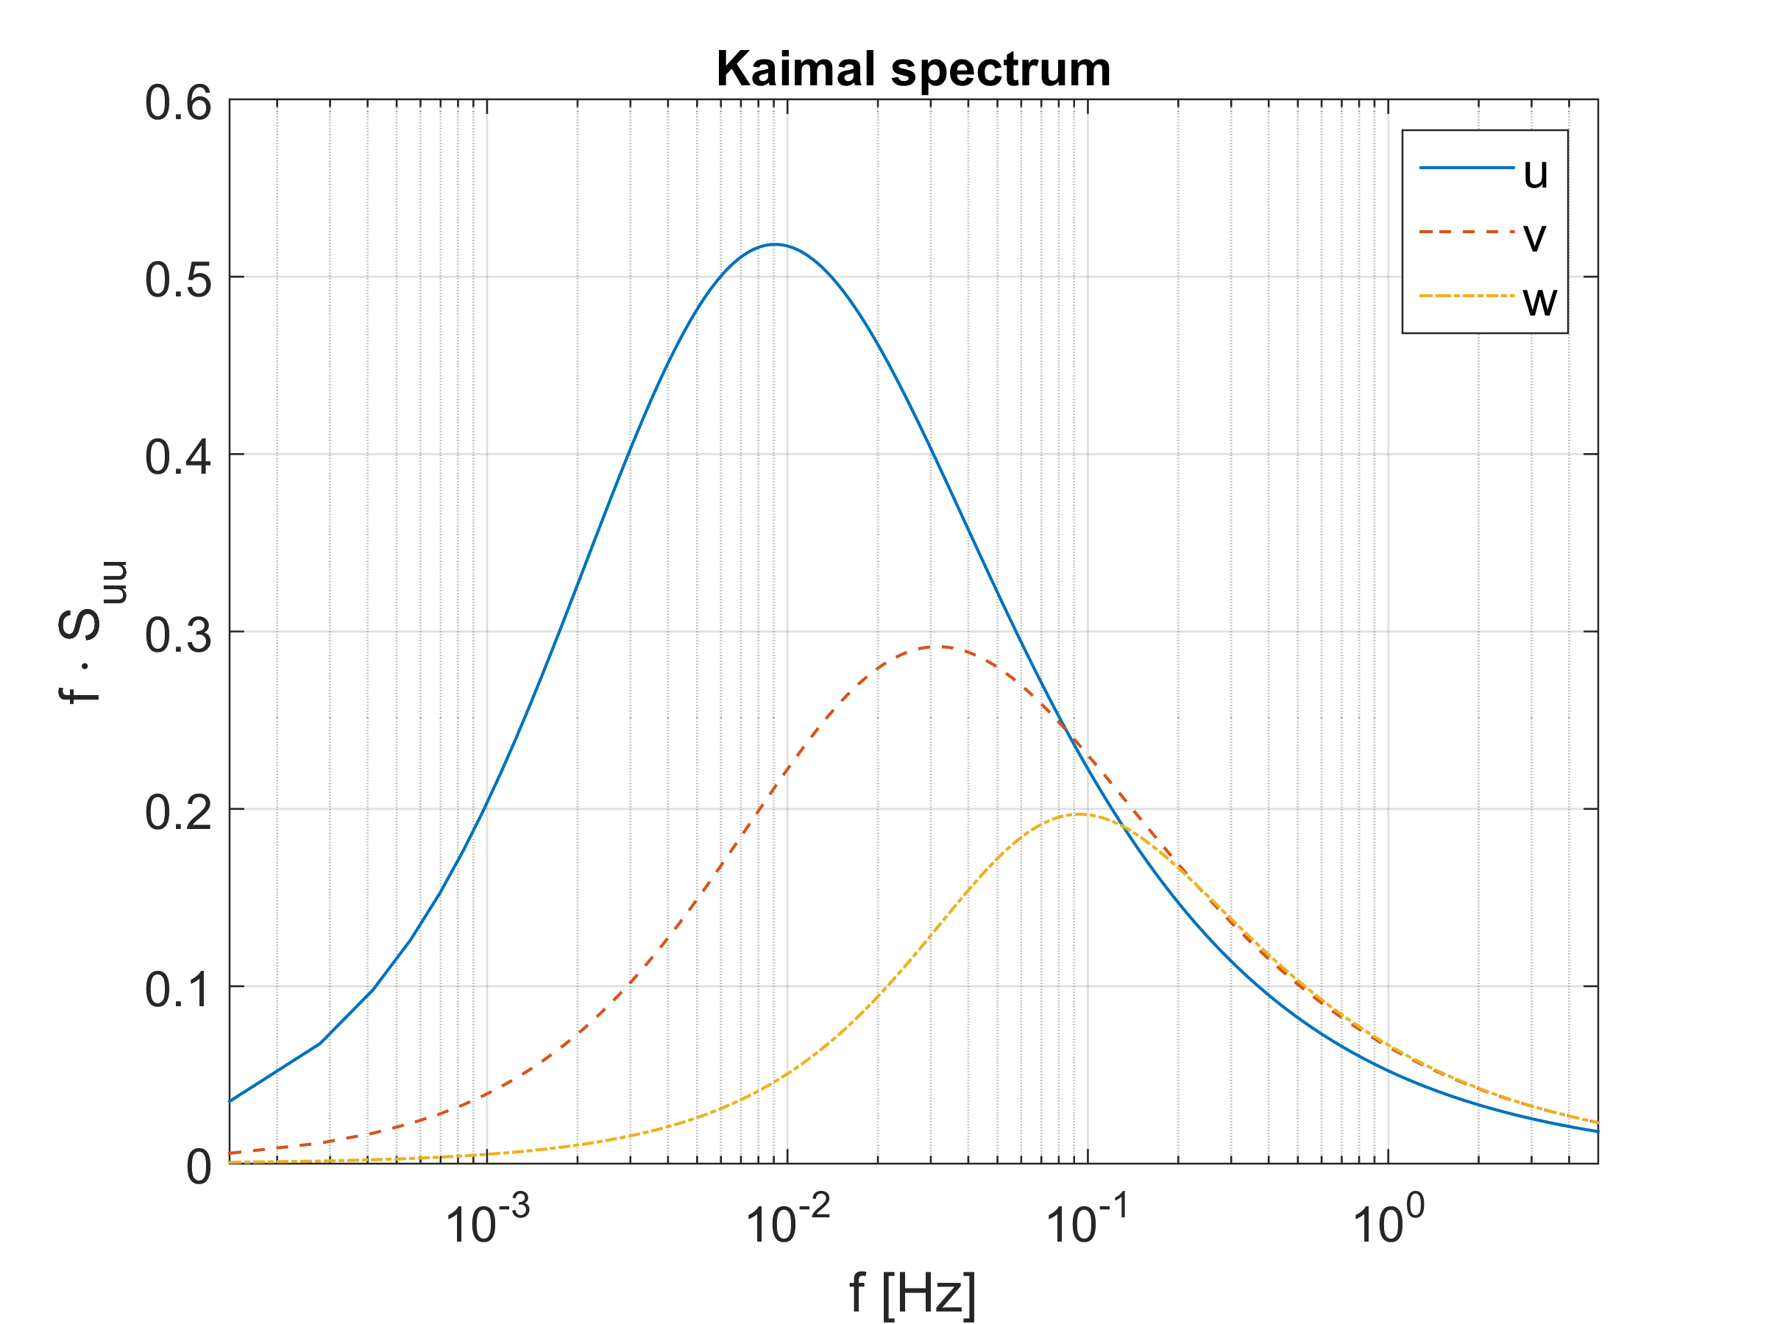
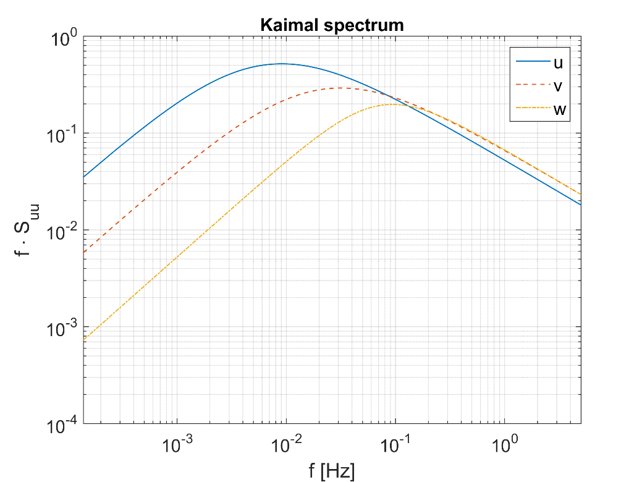
Wind velocity spectra
Power spectrum = statistical description of the time series: variance, in frequency domain
Notes:
note: uncertainty of spectrum increases with 1/f due to sampling (uncertainty at lowest f is same magnitude as spectrum itself !)

Slide 15
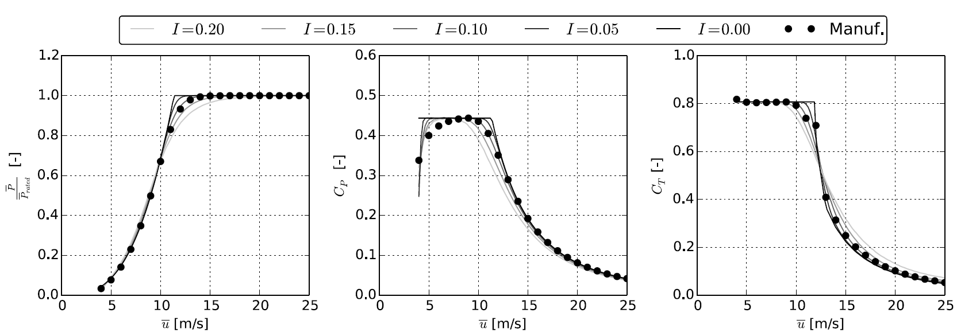
Electrical power output
Uncertain due to many reasons; for example: turbulence, aerodynamic coefficients, yaw mis-alignment, site assessment
1% under-prediction of power production is 1% less income (financial risk)!
reducing uncertainty also has cost (research, improved obs./materials, etc.)

Slide 16
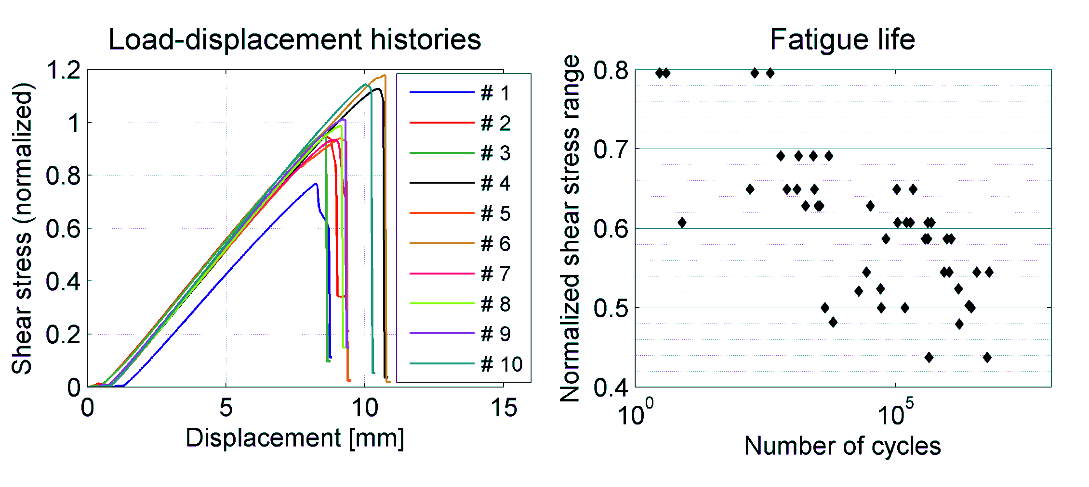
Materials
Do we know exactly how strong the material is?

Slide 17
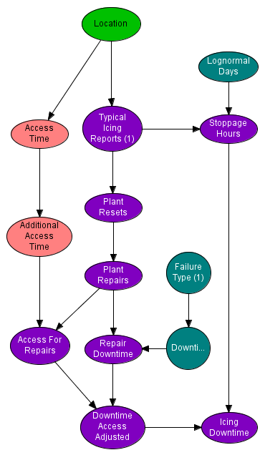
Operation & Maintenance
Are really all failures predicted by our models? Do they happen when expected?

Slide 18
The UQ space
Problem formulation
Probabilistic characterization
Sampling & integration
Data analysis
Model uncertainty quantification
Scope & objectives
Variables
Reliability methods
Uncertainty propagation
Extreme value analysis
Measurement unc. quantification
Limit states
Load cases
Surrogate models
Efficient sampling techniques
Distribution fitting
Uncertainty regression models
Creating insights / value
Uncertainty reduction
RBDO
Design calibration
Risk-based decision making
Sensitivity analysis
Safety factor calibration

Slide 19
Reliability-based design
Level 1: Reduce the probability of failure to an acceptable level by applying partial safety factors
Level 2: Define the design variables in terms of mean values and uncertainty (e.g. standard deviation)
Level 3: Ensure that the probability of failure does not exceed the target failure probability in any given time period.
Level 4: Calculate cost-optimal reliability based on estimation of failure frequencies and failure consequences.

Slide 20
Design under uncertainty
Geometry
Material properties
Material strength
Defects
Controller
Aerodynamics
Wake effects
Soil conditions
Environment
Structural resistance model
Load model
Joint distribution of input variables
Reliability model
Cost model
Input uncertainties (mean, std.dev)
Risk
Failure probability
Influence factors
Design point
Safety factors
Cost-optimal reliability
Reliability-based design / RBDO
Partial coefficient- based design
Uncertainty propagation model
Risk-based, cost-optimized design
Uncertainty estimation
Level 4
Level 3
Level 1
Level 2

Slide 21
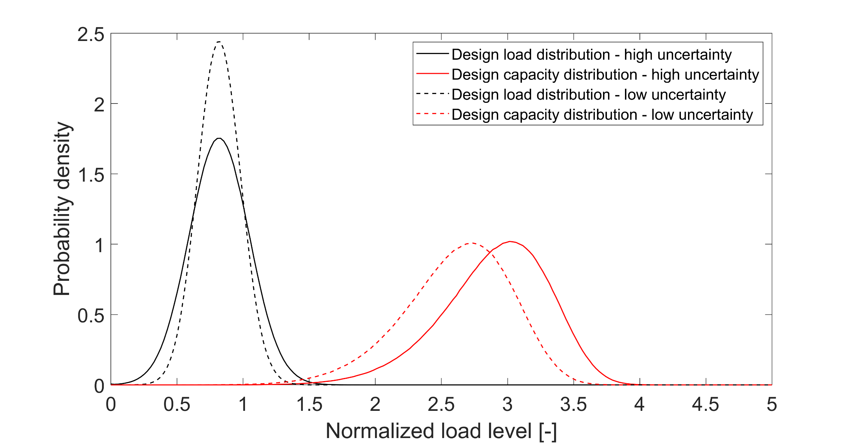
From uncertainty reduction to less material use
Reduction in required design capacity

Slide 22
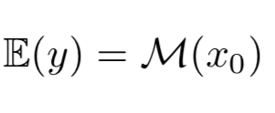
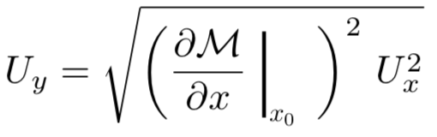
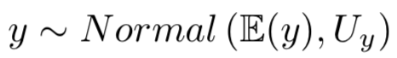
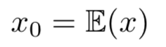

Input Uncertainty Propagation: GUM, Taylor
Linearized model (Taylor series) around the expected value of the inputs.
$$x_{real} \sim Normal\left\{x_{0},U_{x}\right\}$$

Slide 23
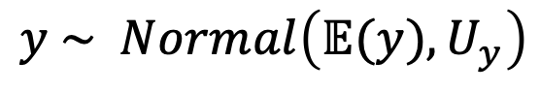
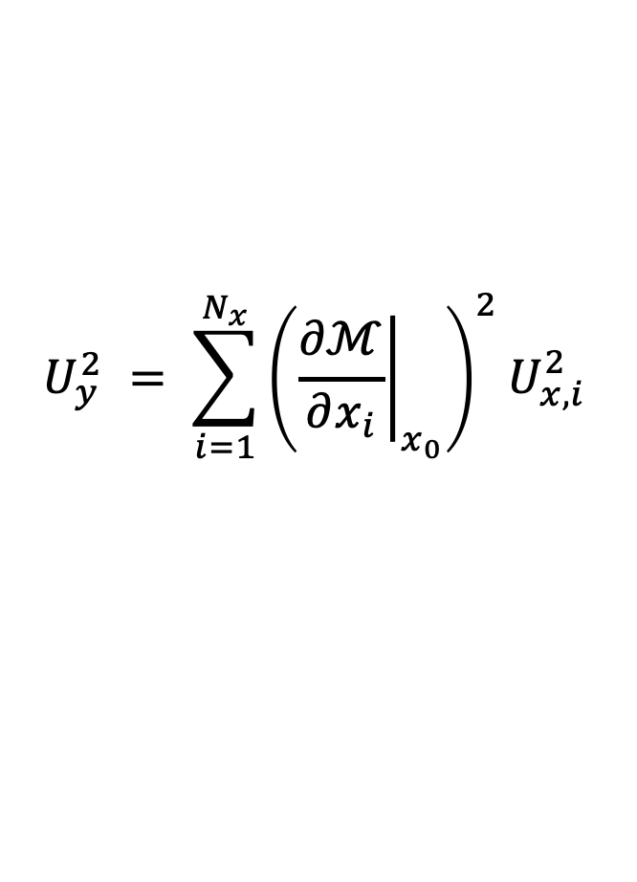
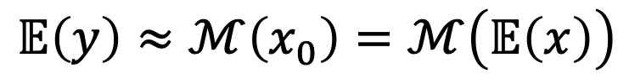
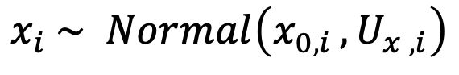
Input Uncertainty Propagation: GUM, Taylor
Multiple uncertain input variables ($x_{i }$):
$$x_{i} \sim Normal\left(x_{0, i },U_{x , i}\right)$$
If the uncertainties are independent, then :
$$𝔼\left(y\right)≈ℳ\left(x_{0}\right)=ℳ\left(𝔼\left(x\right)\right)$$
$$U_{y}^{2} = \sum_{i=1}^{N_{x}}{{\left({\left.\frac{∂ℳ}{∂x_{i}}\right|}_{x_{0}}\right)}^{2}U_{x,i}^{2}}$$
$$y \sim Normal\left(𝔼(y),U_{y}\right)$$

Slide 24
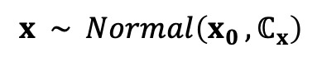
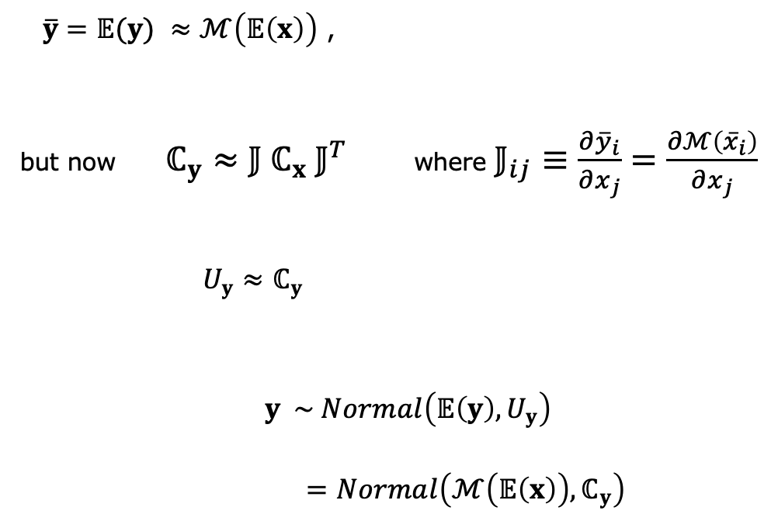
Input Uncertainty Propagation: GUM, Taylor
Multiple uncertain input variables and multiple outputs.
If uncertainties are correlated for both inputs and outputs.
$$x \sim Normal\left(x_{0 },ℂ_{x}\right)$$
$\overline{y}=𝔼(y) ≈ℳ\left(𝔼\left(x\right)\right)$ ,
but now $ℂ_{y}≈{𝕁 ℂ}_{x}{ 𝕁}^{T}$ where $𝕁_{ij}≡\frac{∂{\overline{y}}_{i}}{∂x_{j}}=\frac{∂ℳ\left({\overline{x}}_{i}\right)}{∂x_{j}}$
$U_{y}≈ℂ_{y}$
$y \sim Normal\left({𝔼\left(y\right),U}_{y}\right)$
$=Normal\left(ℳ\left(𝔼\left(x\right)\right),ℂ_{y}\right)$

Slide 25


Funding scheme
This project has received funding from the European Union’s Horizon 2020 Research and Innovation Programme under Grant Agreement No. 101006689
Project Coordinator
Nikolay Krasimirov Dimitrov
DTU Wind and Energy Systems
nkdi@dtu.dk

